Slide 1






Edu-Chain: Revolutionizing Academic Verification
Tired of forged certificates and slow verification?
Edu-Chain offers a secure, digital solution for academic records, built on the blockchain.
Notes:
1

Slide 2



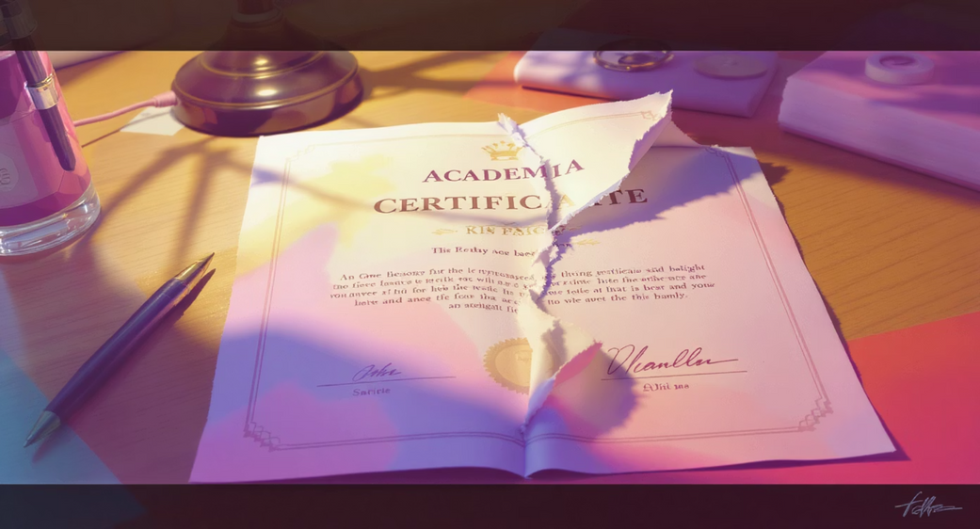
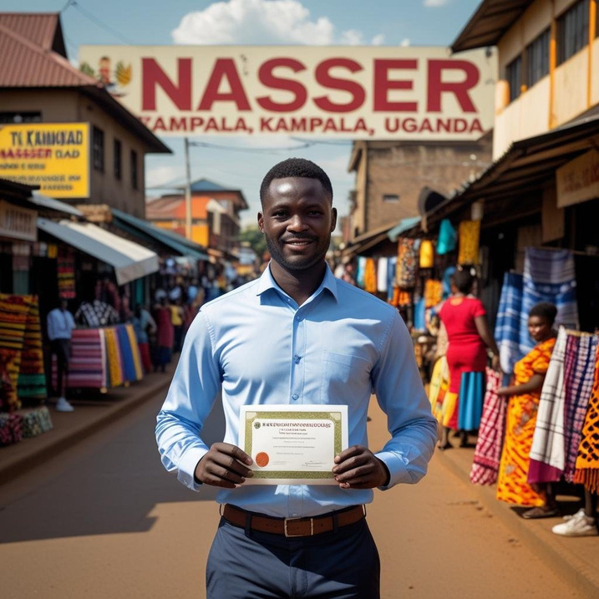
The Problem: Forgery and Delays
In Uganda, the challenges of academic fraud and inefficient verification are significant, impacting educational integrity and employment opportunities. Our project addresses these critical issues head-on.
Rampant Forgery
Eroding Trust
Fake transcripts undermine trust in qualifications.
Fake documents devalue legitimate qualifications.
Slow Verification
Economic Impact
Manual processes cause delays for employers and institutions.
Fraudulent credentials lead to unqualified hires.
Lost Documents
Systemic Inefficiency
Paper certificates easily lost or damaged.
Manual checks strain institutional resources.
Notes:
2

Slide 3

Our Solution: Blockchain-Powered Certificates
Immutable Data
NFT Minting
Student info stored securely on-chain.
Each certificate: unique NFT on Base blockchain.
Student Ownership
IPFS Storage
Records delivered to digital wallets.
Full certificate content on IPFS, tamper-proof.
Certify Chain leverages the Base blockchain to create secure, verifiable academic credentials, empowering students and institutions.
Instant Verification
Employers check authenticity in seconds.
Fraud Elimination
Tamper-proof records ensure integrity.
Digital Transformation
Supports Uganda's national digital goals.
Our project can also be extended to include report cards, transcripts, and other academic records, all verifiable and accessible online.
Notes:
3

